Slide 1
JENKINS Installation
Installation and Configurations

Slide 2
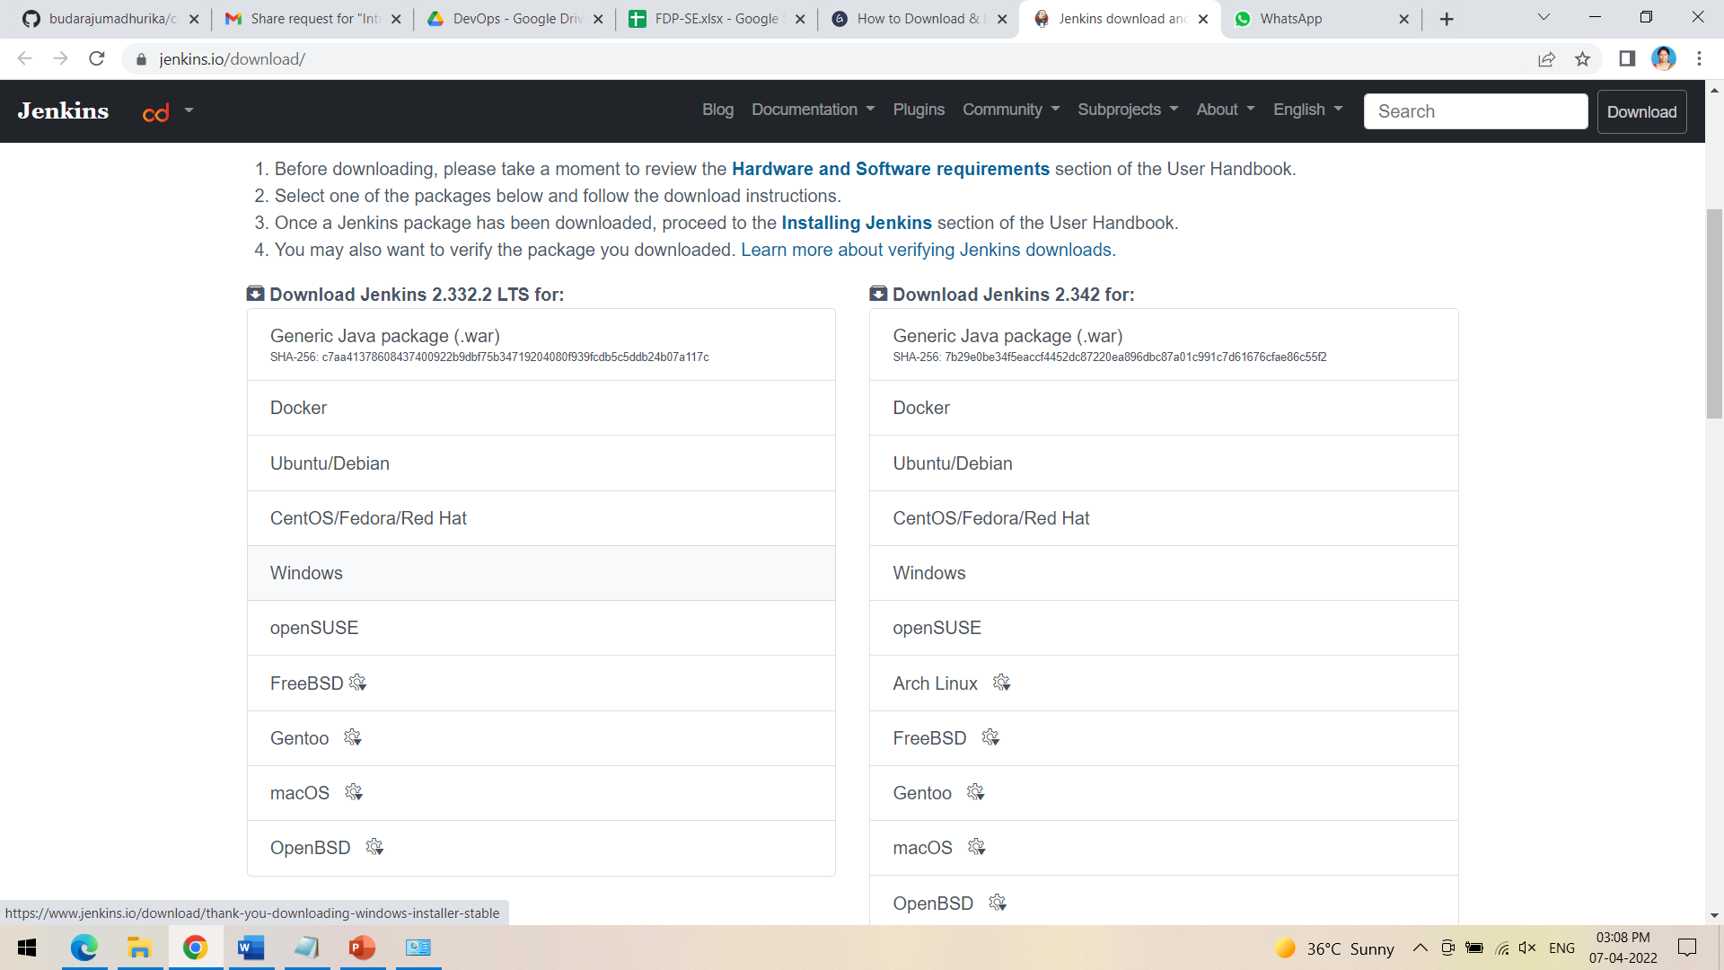
HOW TO DOWNLOAD JENKINS?
Following steps should be followed so that to install Jenkins successfully:
Step 1) Go to https://www.jenkins.io/download/ and select the platform. In our case Windows

Slide 3
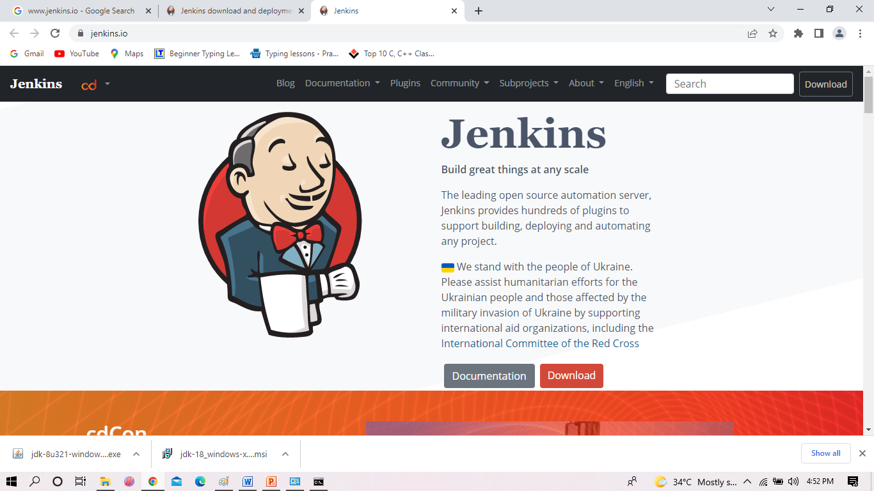
Download JENKINS

Slide 4
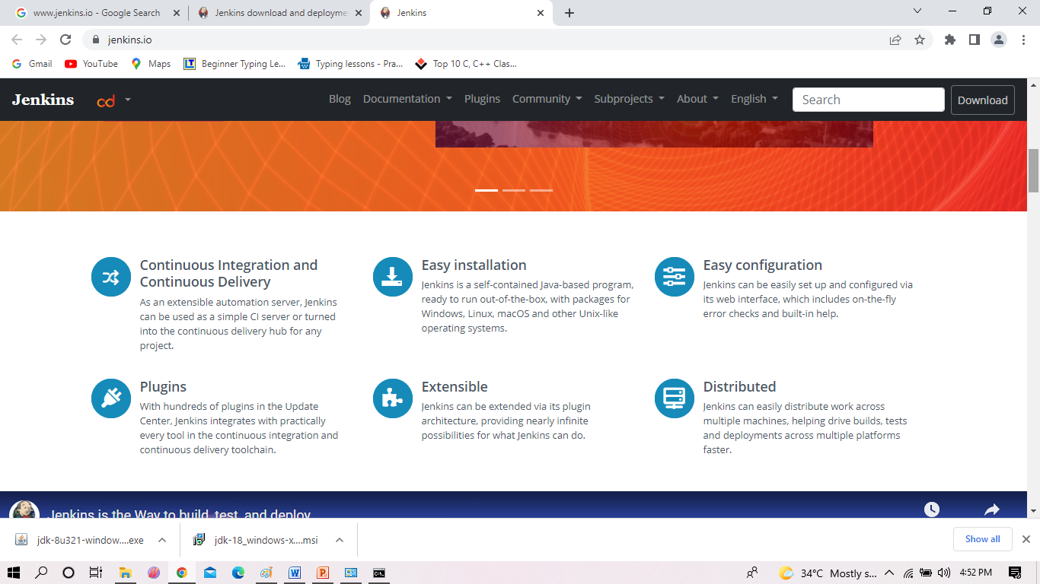
DOWNLOAD JENKINS

Slide 5
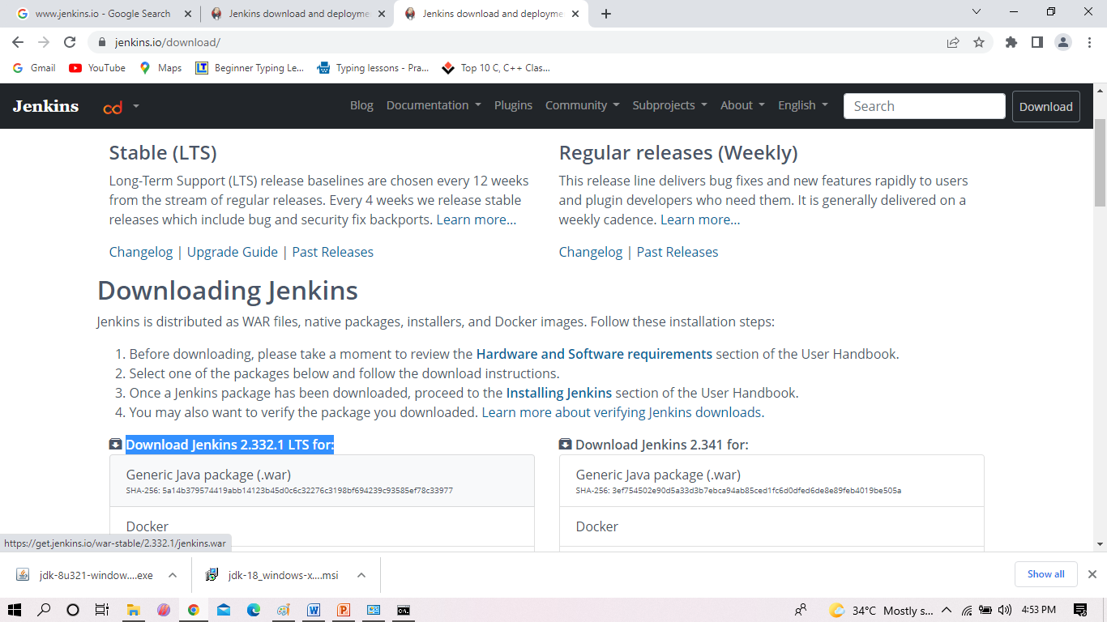
DOWNLOAD JENKINS AS SHOWN

Slide 6
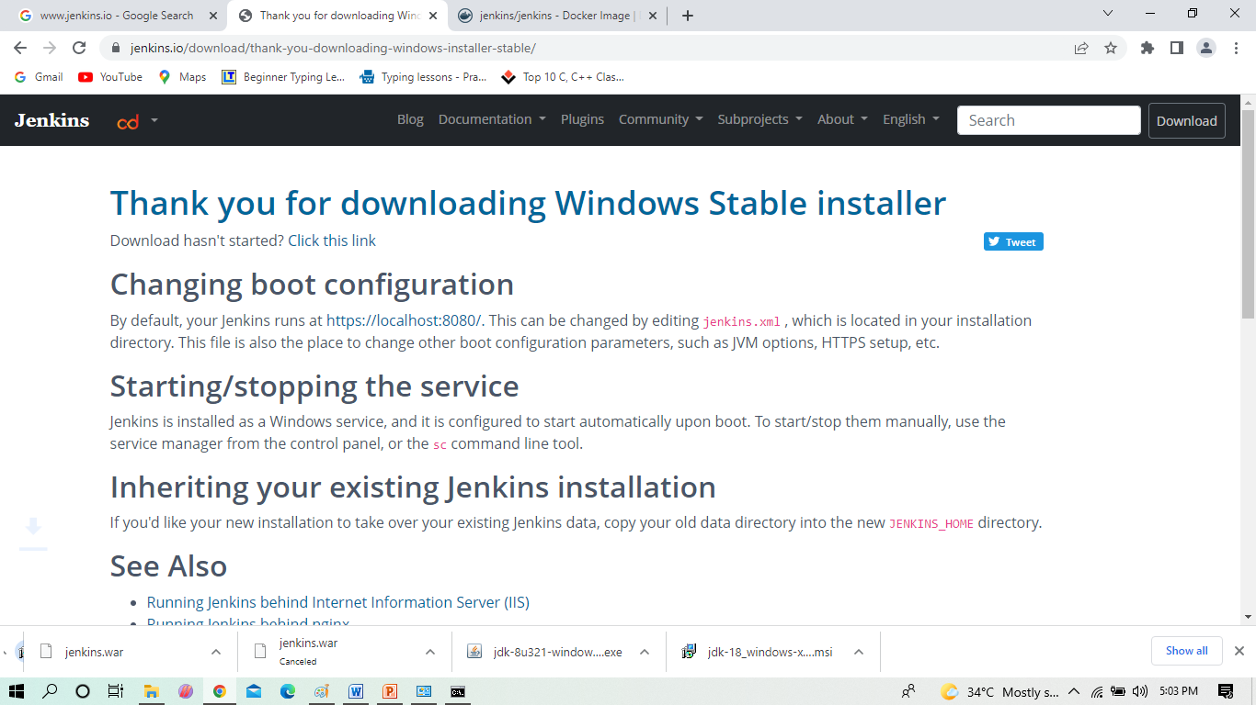
DOWNLOAD JENKINS

Slide 7
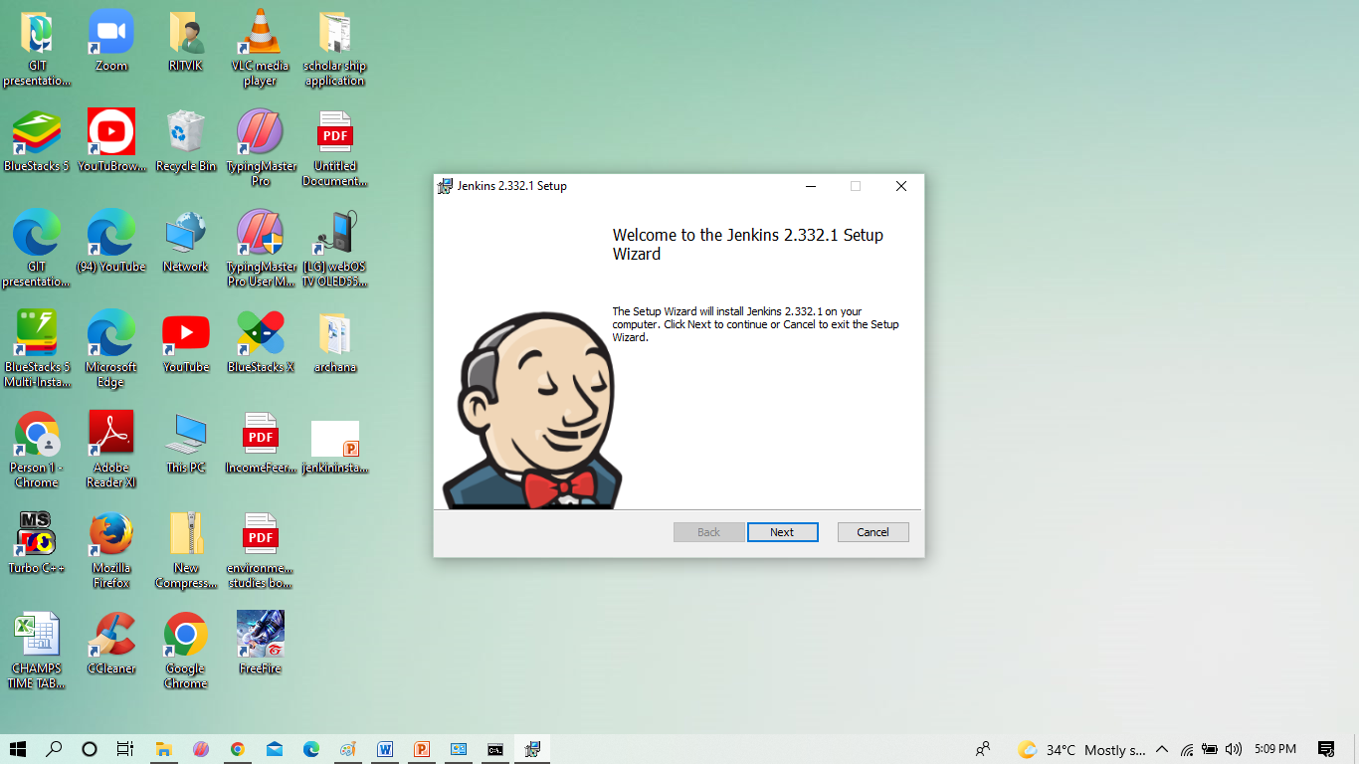
Installation of Jenkins

Slide 8
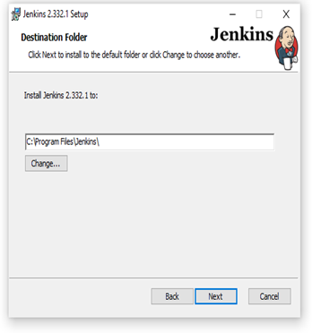
Installation of Jenkins Contd..

Slide 9
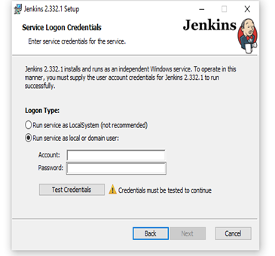
Installation of Jenkins Contd..

Slide 10
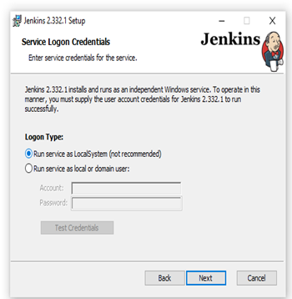
Installation of Jenkins Contd..

Slide 11
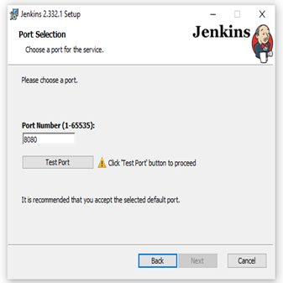
Installation of Jenkins Contd..

Slide 12
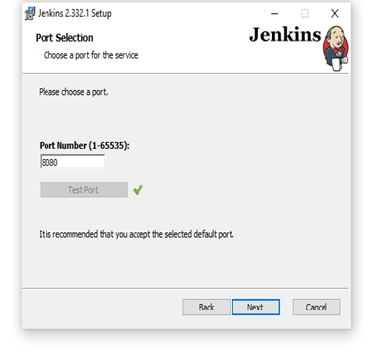
Installation of Jenkins Contd..

Slide 13
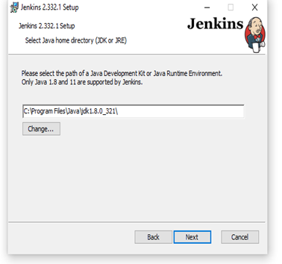
Installation of Jenkins Contd..

Slide 14
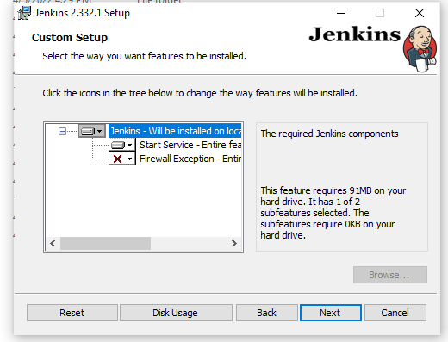
Installation of Jenkins Contd..

Slide 15
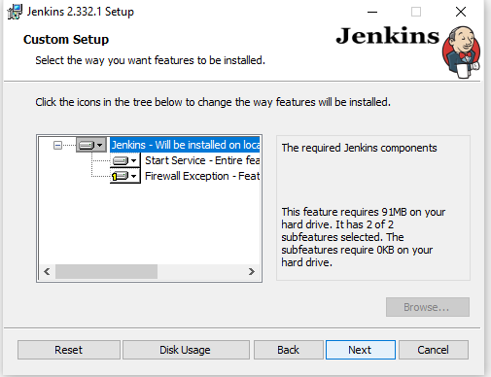
Installation of Jenkins Contd..

Slide 16
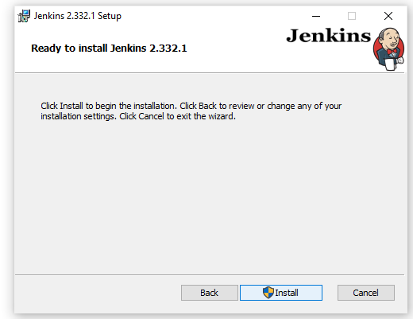
Installation of Jenkins Contd..

Slide 17
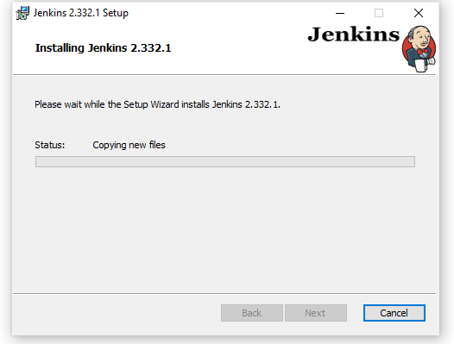
Installation of Jenkins Contd..

Slide 18
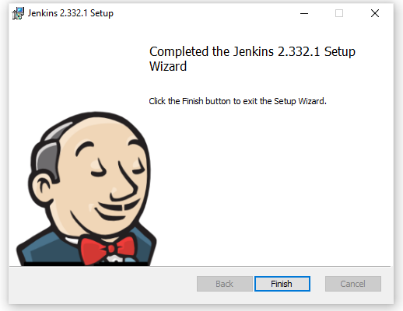
Installation of Jenkins Contd..

Slide 19
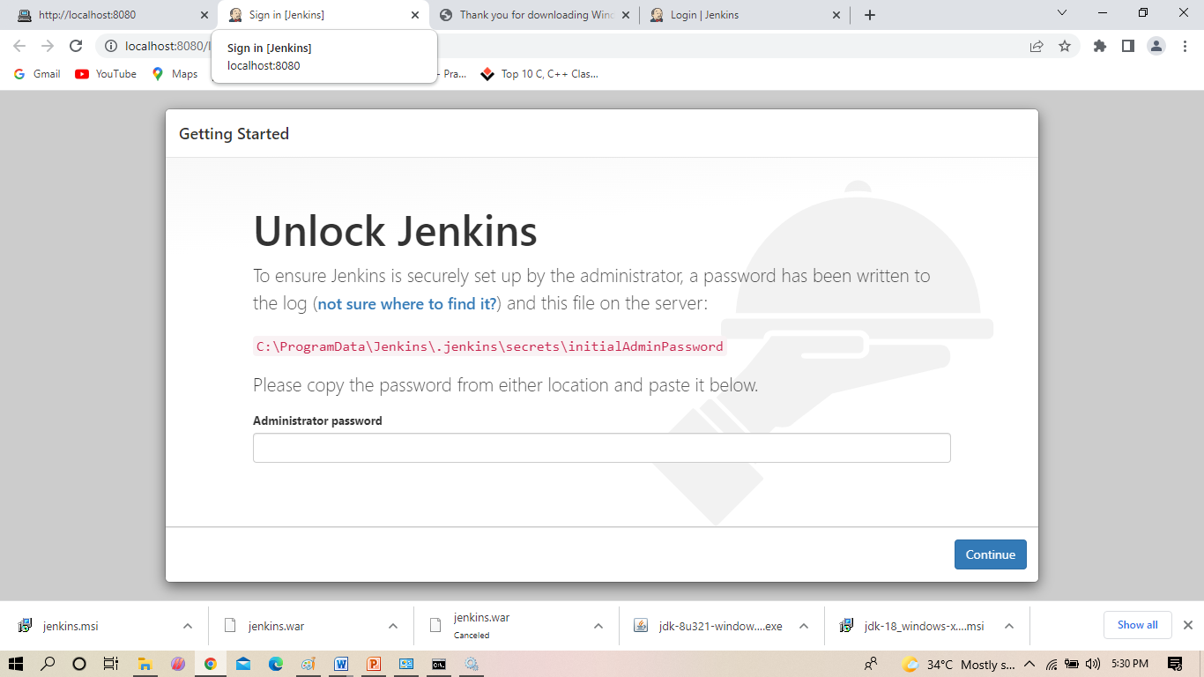
Go to the path as shown

Slide 20
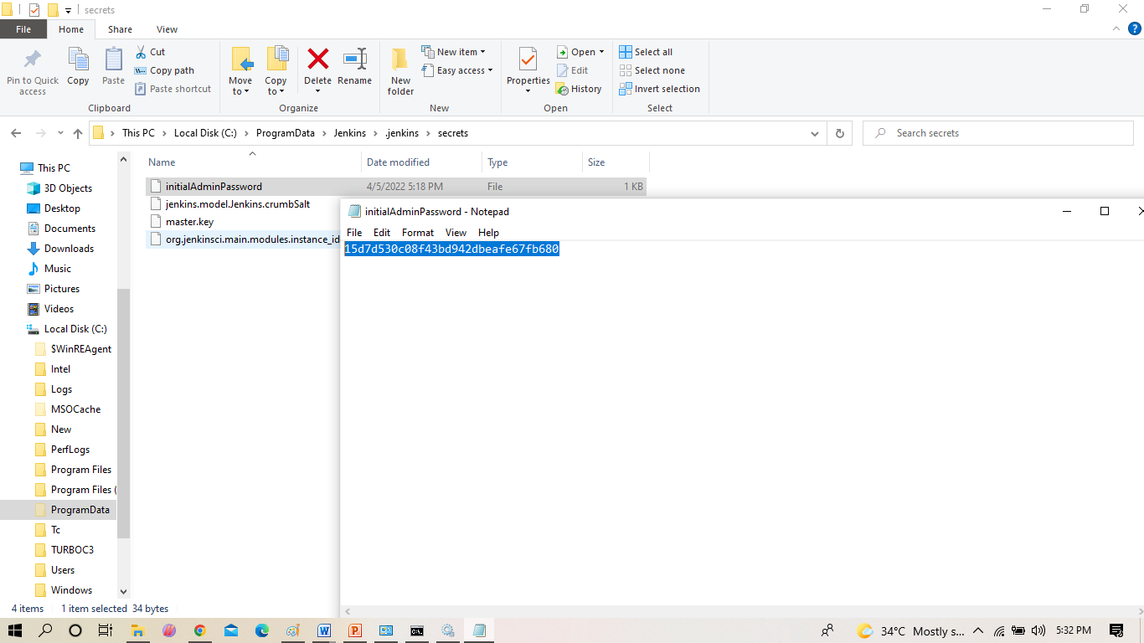
COPY THE PASSWORD

Slide 21
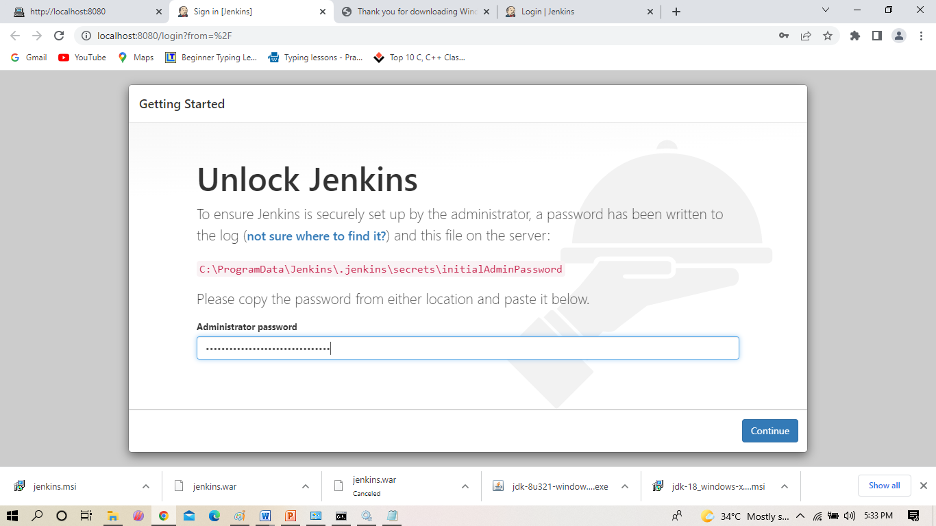
PASTE AS SHOWN IN THE ADMINISTRATOR PASSWORD BLOCK

Slide 22
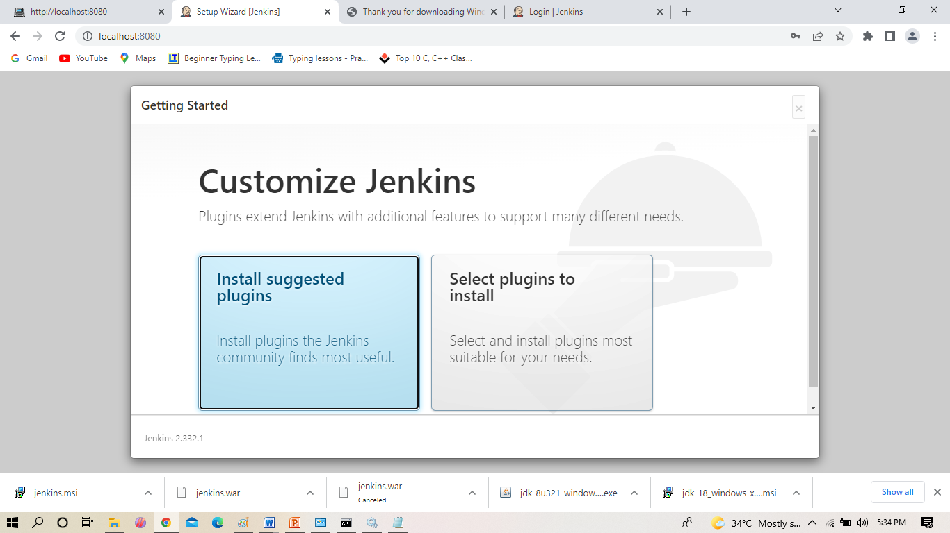
Installation of Jenkins PLUGINS

Slide 23
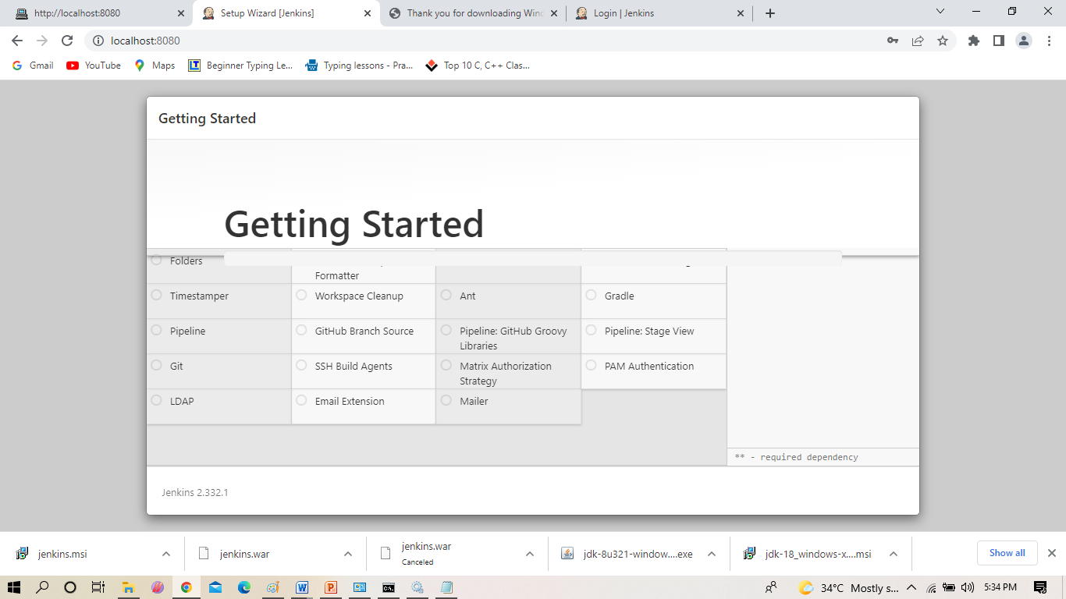
Installation of Jenkins Contd..

Slide 24
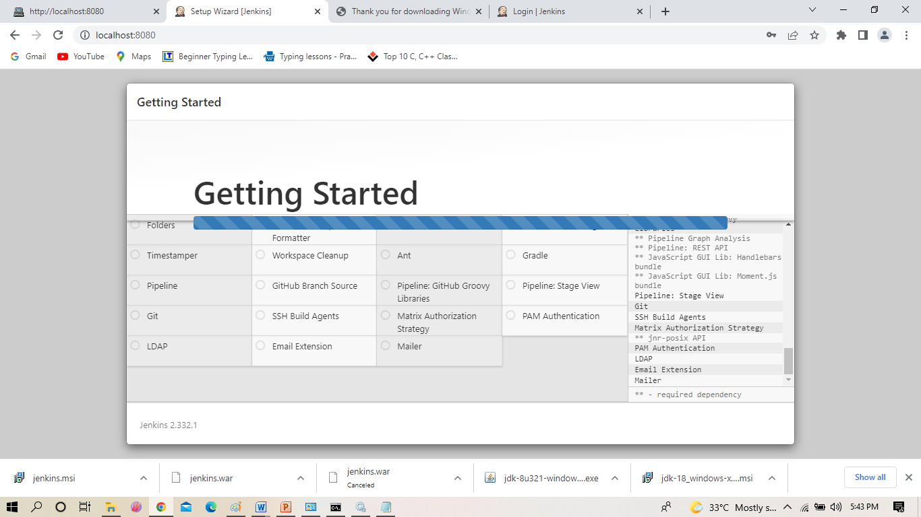
Installation of Jenkins Contd..

Slide 25
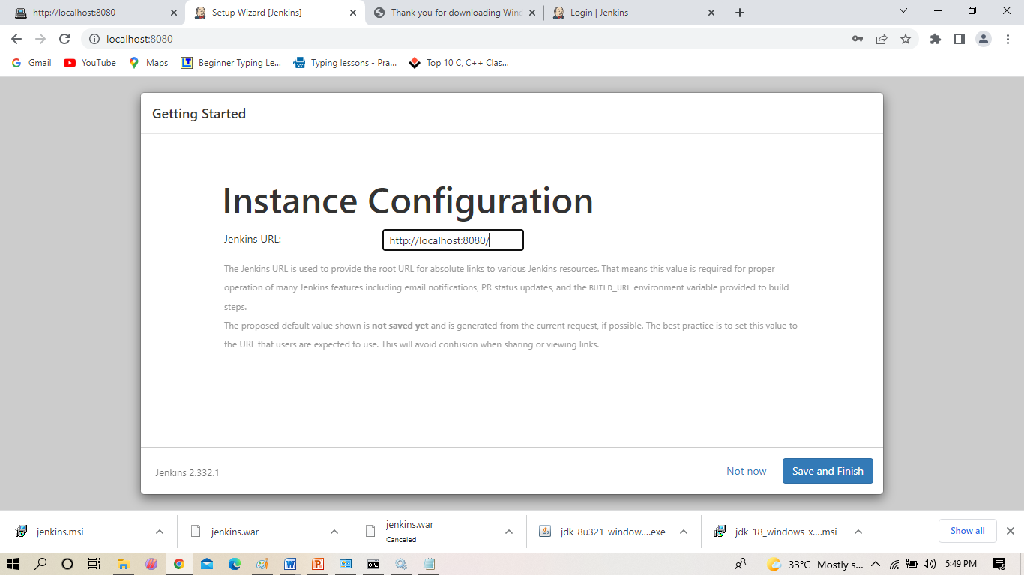
Installation of Jenkins Contd..

Slide 26
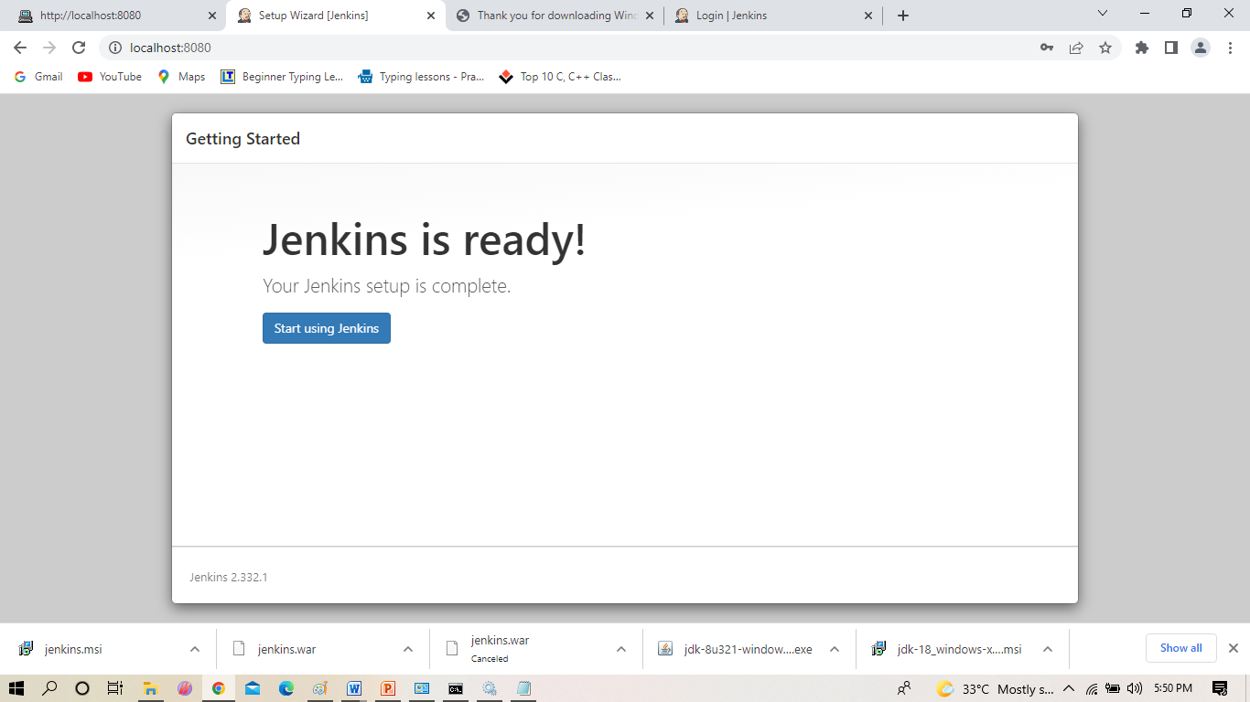
Installation of Jenkins Contd..

Slide 27
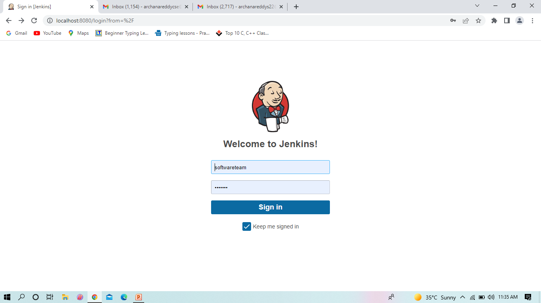
JENKINS DASHBOARD

Slide 28
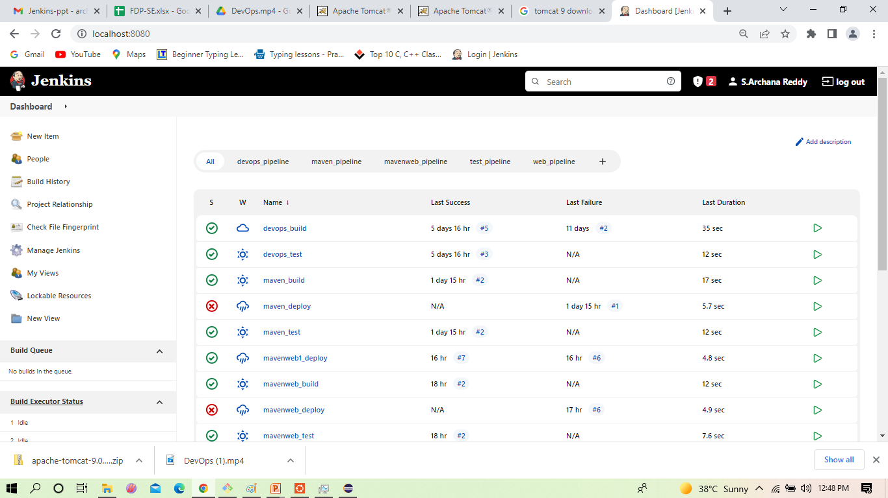
Select ->Manage jenkins
Install plugins in Jenkins Contd..

Slide 29
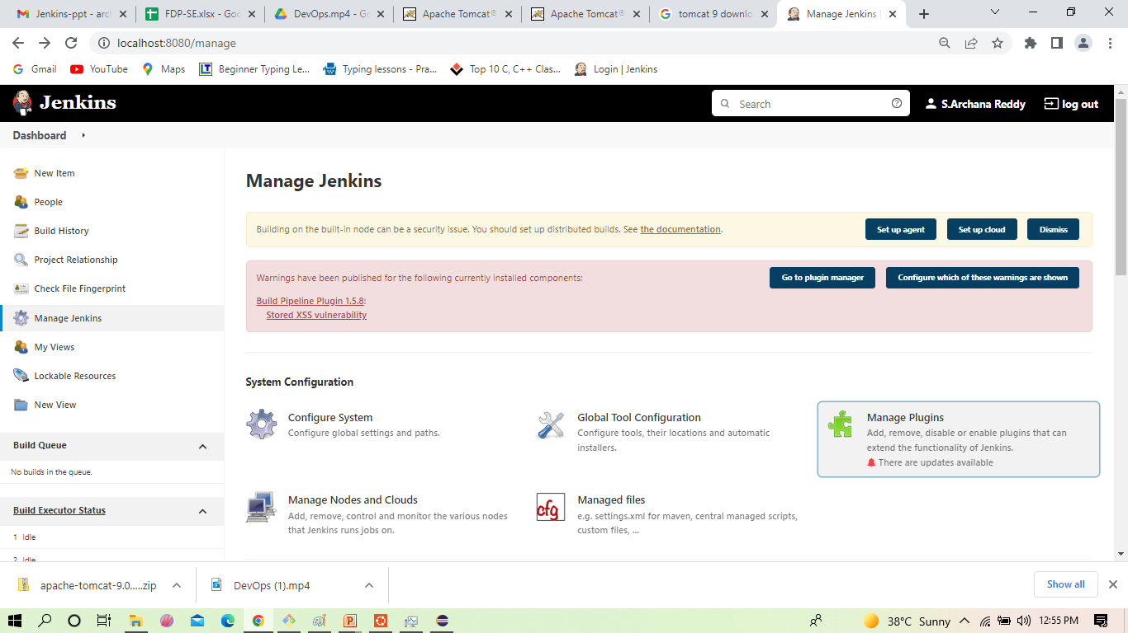
Click on manage jenkins
Installation of Jenkins Contd..

Slide 30
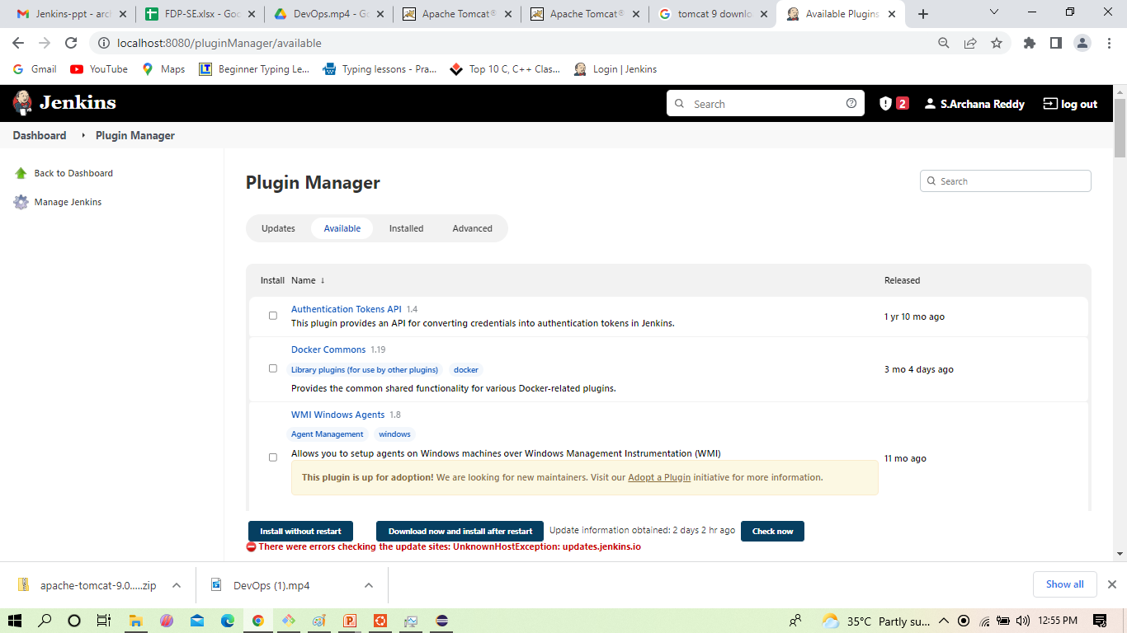
.
Install plugins in Jenkins Contd..
Check in the available and install the plugins Maven integration plugin, Build pipeline plugin, Pipeline utility, Copy artifacts, Deploy to container . click on -> install without restart

Slide 31
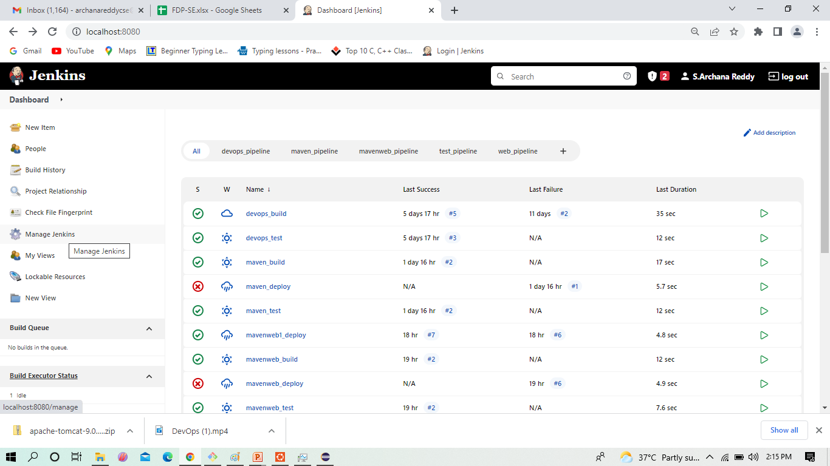
How to config your Jenkins with Maven

Slide 32
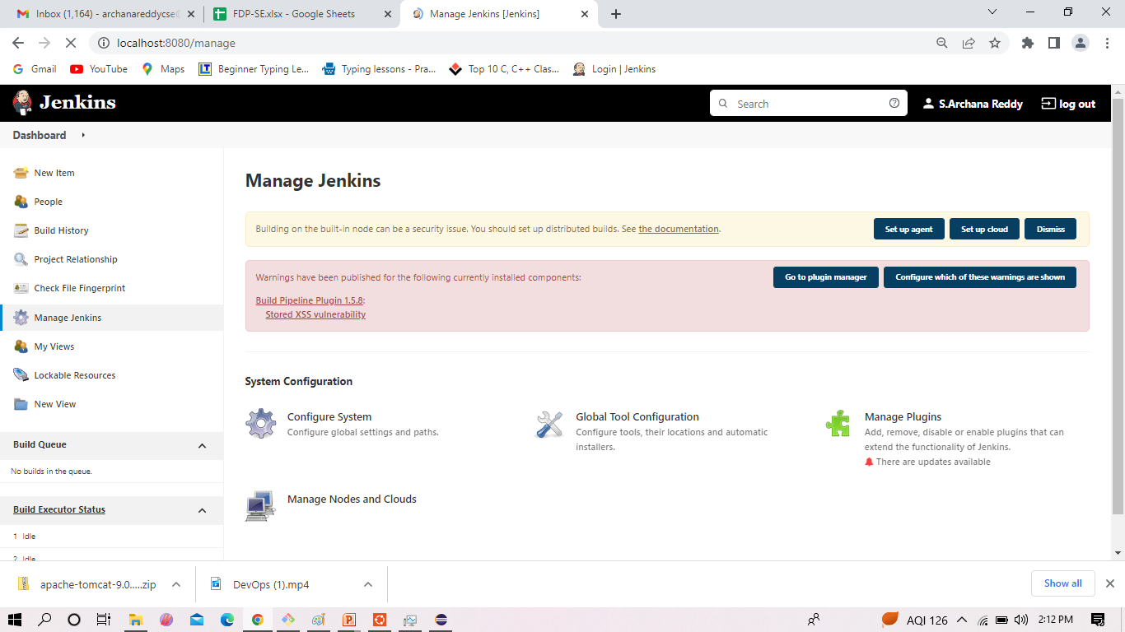
Select ->Global tool Configuration

Slide 33
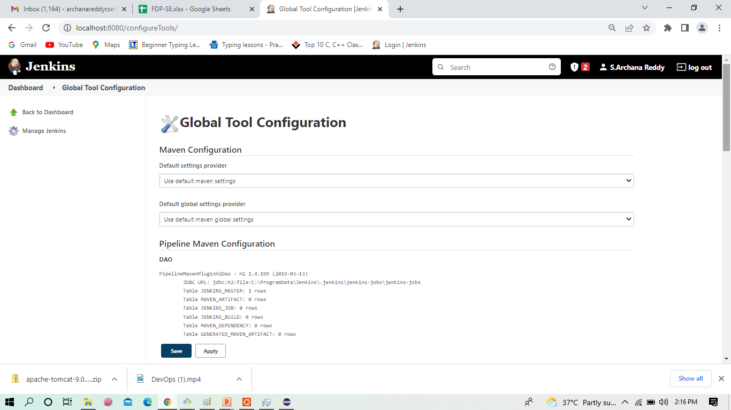
Page of Global Tool Configuration in same page go down for JDK

Slide 34
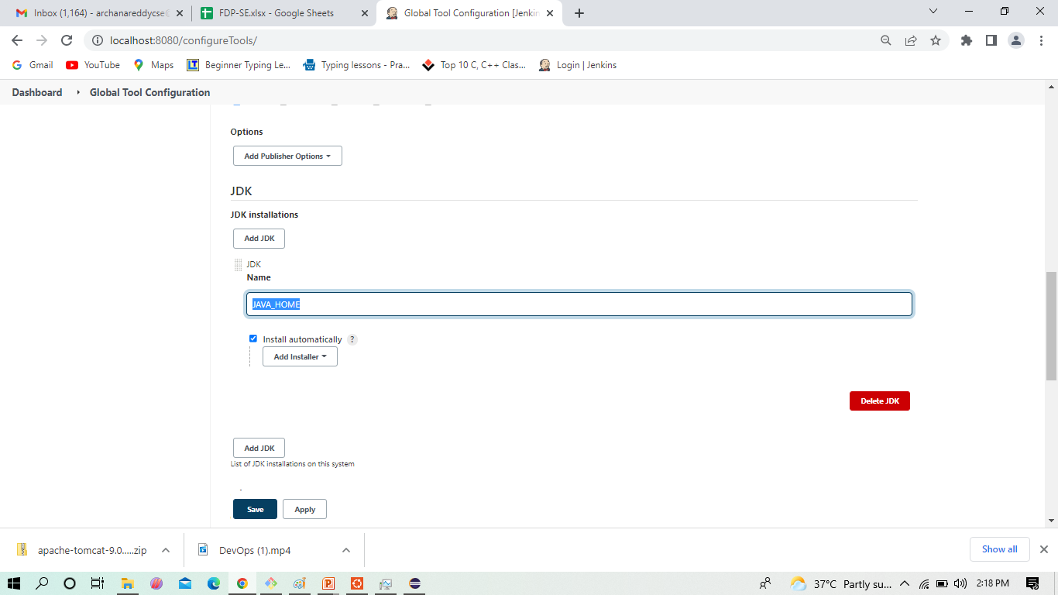
Here give the JAVA_HOME path

Slide 35
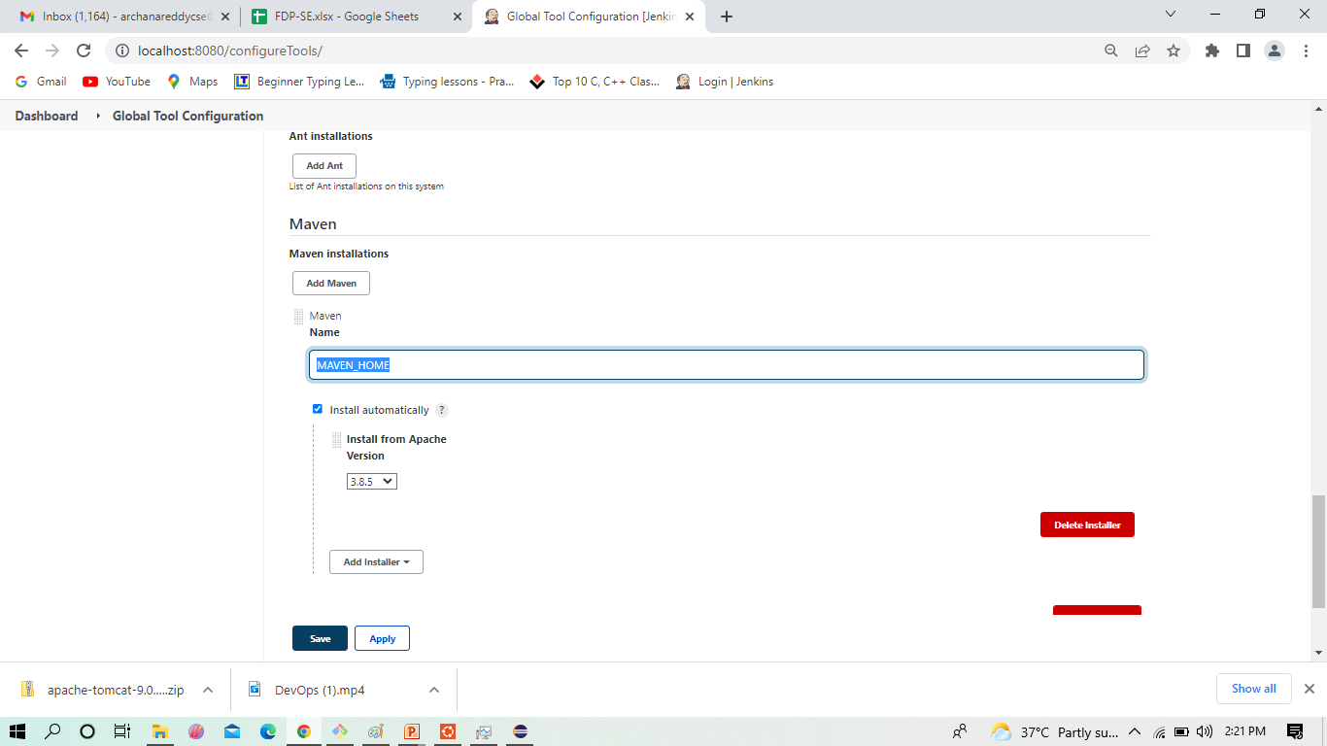
Next give the MAVEN _HOME path

Slide 36
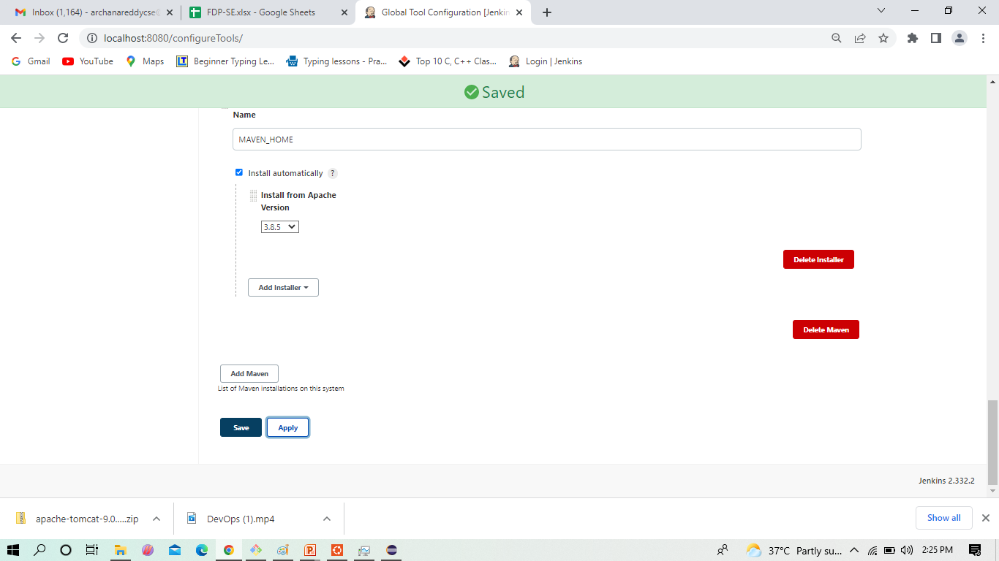
Click -> Apply and Save

